Slide 1
Computer Organization TCS-404 Unit – I Part II
Introduction
By:
Dr. Gourav Verma

Slide 2
Data Representation in Computer Systems:
Signed Integer Representation,
Complement Systems: One’s complement and Two’s complement,
Addition and Subtraction using signed numbers,
Multiplication of Positive Numbers,
Signed Operand Multiplication,
Integer Division;
Floating Point Representation, ,
The IEEE-754 Floating Point Standard,Floating Point Arithmetic, Floating Point Errors

Slide 3
Signed Integer Representation
Consider an n-bit vector
B = b_{n−1} . . . B₁b₀ ex.:010010…
where b_{i} = 0 or 1 for 0 ≤ i ≤ n − 1. This vector can represent an unsigned integer value
V(B) in the range 0 to 2_{n − 1}, where
V(B) = b_{n−1} × 2_{n−1} +· · ·+b₁ × 2¹ + b₀ × 2⁰
Ex.: if there are 4 bit number: 1010 than it can be represented as 1x2³+ 0x2² + 1x2¹ + 0x2⁰=
=8+2=(10)₁₀
We need to represent both positive and negative numbers. Three systems are used for representing such numbers:
• Sign-and-magnitude
• 1’s-complement
• 2’s-complement

Slide 5
Note that there are distinct representations for +0 and −0 in both the sign-and magnitude and 1’s-complement systems, but the 2’s-complement system has only one representation for 0. For 4-bit numbers, as shown in last slide Figure , the value −8 is representable in the 2’s-complement system but not in the other systems. The sign-and-magnitude system seems the most natural, because we deal with sign-and-magnitude decimal values in manual computations. The 1’s-complement system is easily related to this system, but the 2’s-complement system may appear somewhat unnatural. However, we will show that the 2’s-complement system leads to the most efficient way to carry out addition and subtraction operations.

Slide 6
Addition of Unsigned Integers

Slide 8
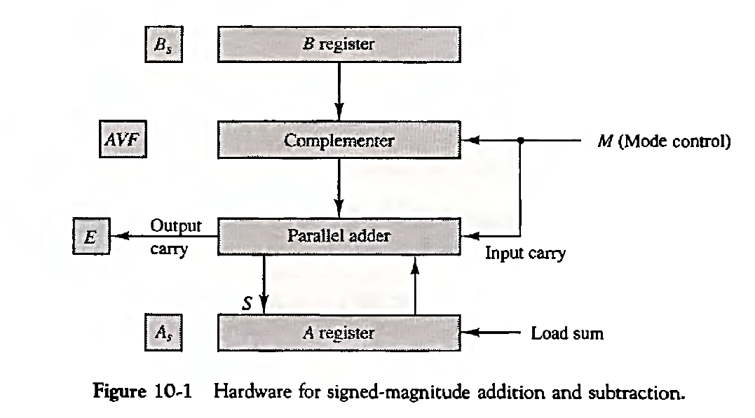
Hardware for Addition and Subtraction of Signed Integers

Slide 9
Hardware for Addition
and Subtraction of Signed
Integers

Slide 10
Hardware for Addition and Subtraction of 2’s Complement Integers

Slide 11
Multiplication Algorithm

Slide 12
Multiplication Algorithm…

Slide 13
Multiplication Algorithm…

Slide 14
Booth’s Multiplication Algorithm…

Slide 15
Division Algorithm

Slide 16
Division Algorithm…

Slide 17
Floating Point Arithmetic Operation
Ex.
Underflow case

Slide 18
Floating Point Arithmetic Operation

Slide 20
Floating Point Multiplication Operation

Slide 21
Floating Point Division Operation

Slide 23
IEEE-754 Floating Point Standard

Slide 24
Most of the binary floating-point representations follow the IEEE-754 standard. The data type float uses IEEE 32-bit single precision format and the data type double uses IEEE 64-bit double precision format

Slide 26
Single Precession Normalized Number

